Slide 1

What’s a Function?

Slide 2
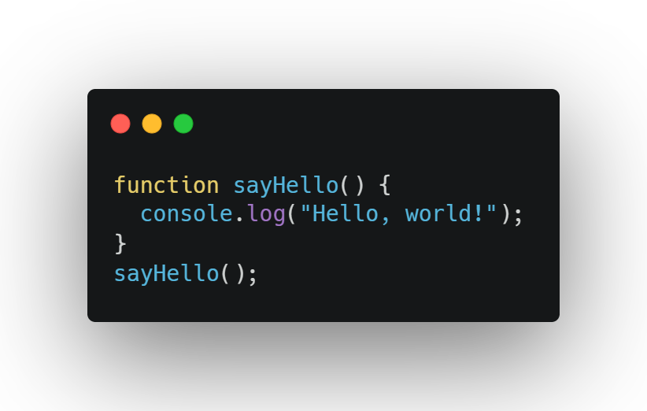
What’s a Function?
A chunk of code that does one job, like adding numbers or saying hi.
You “call” it to make it run, and it can give you a result.

Slide 3

Why Use Functions?
Save time by reusing code.
Keep code organized and easy to read.
Do tasks like calculating scores or greeting users.

Slide 4
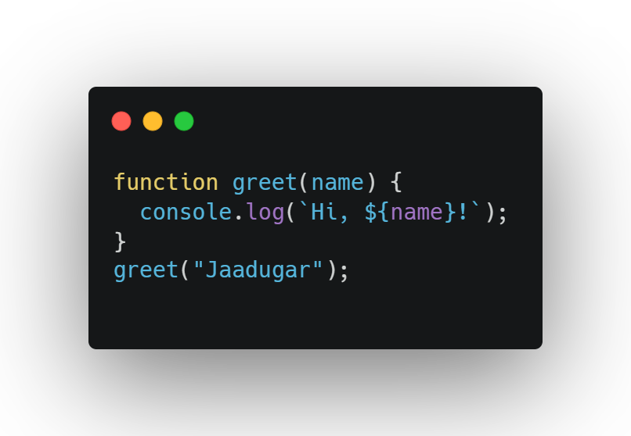
How to Create Functions:
Declaration: Use function keyword with a name.

Slide 5
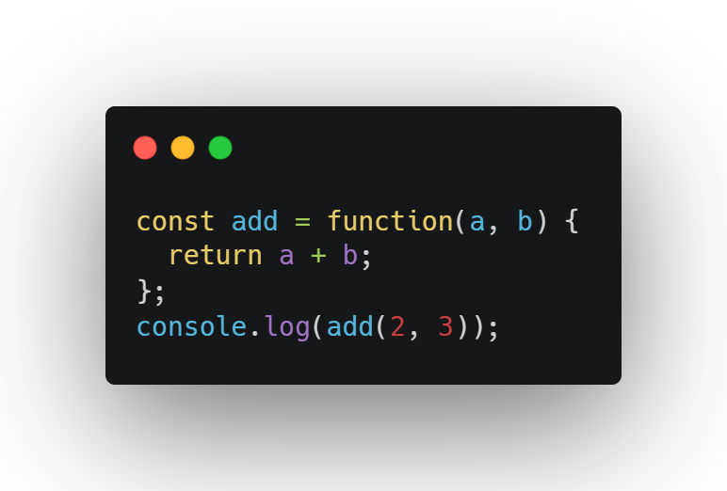
How to Create Functions:
Expression: Store a function in a variable.

Slide 6
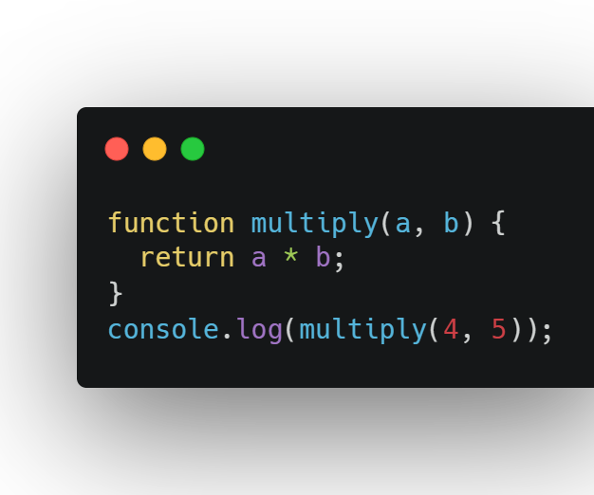
Parameters:
Inputs you give the function, like name or a, b.
Use them inside the function to do the job.

Slide 7
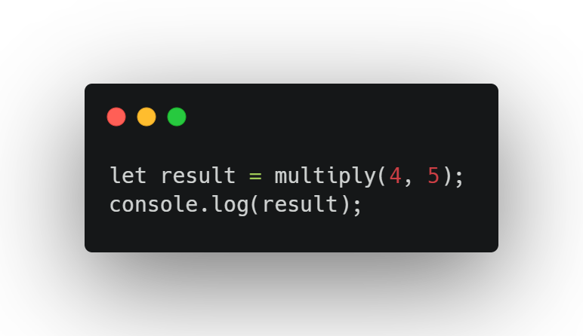
Return:
Gives back a result to use later.

Slide 8

Tips:
Name functions clearly (e.g., greet, calculate).
Use return if you want a result; without it, you get undefined.
Call functions as many times as you want!

Slide 9

Function Details

Slide 10
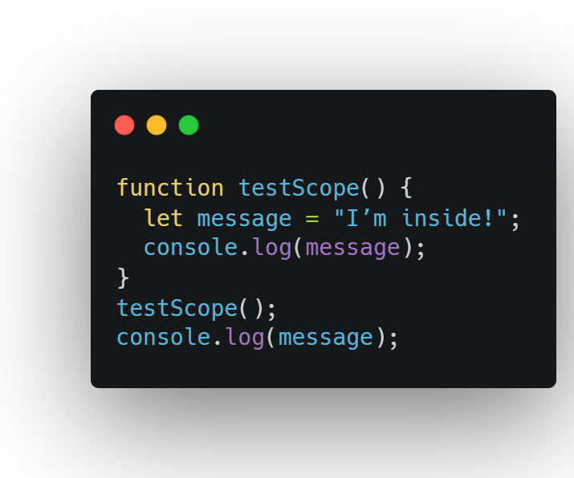
Scope:
Variables inside a function are “local” (only work inside).
Variables outside are “global” and can be used inside functions.

Slide 11
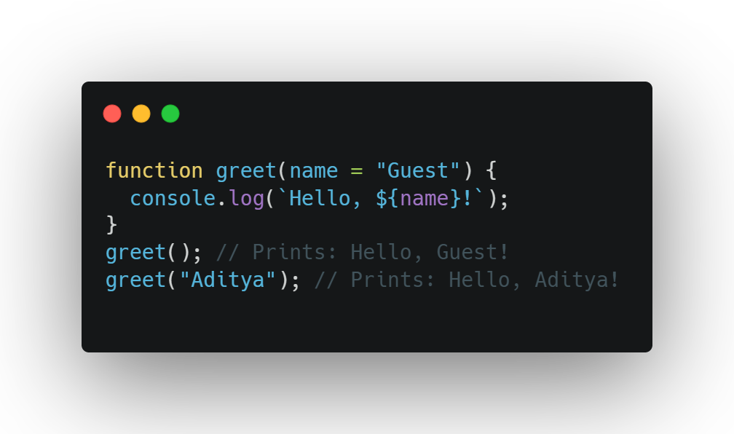
Default Parameters
Set a default value if no input is given.

Slide 12
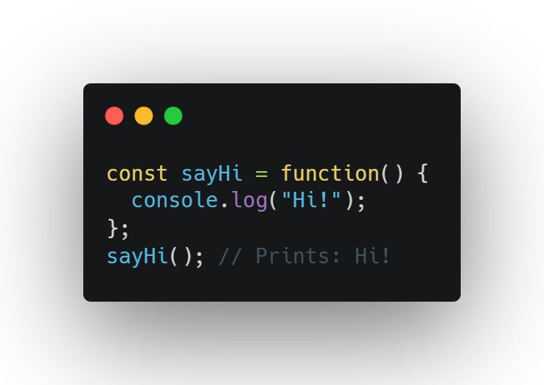
Anonymous Functions
Functions without a name, often used in expressions.

Slide 13
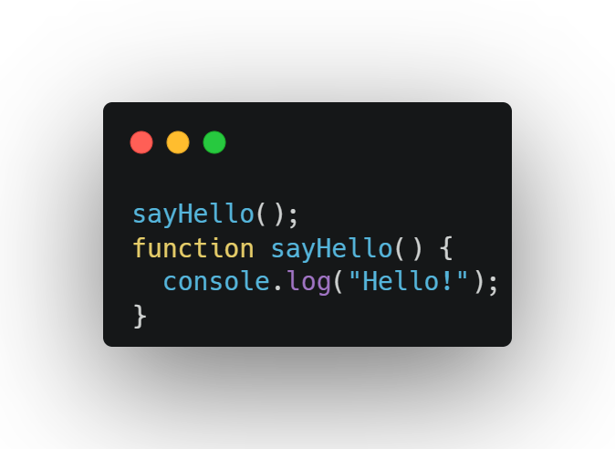
Hoisting:
Function declarations can be called before they’re written

Slide 14
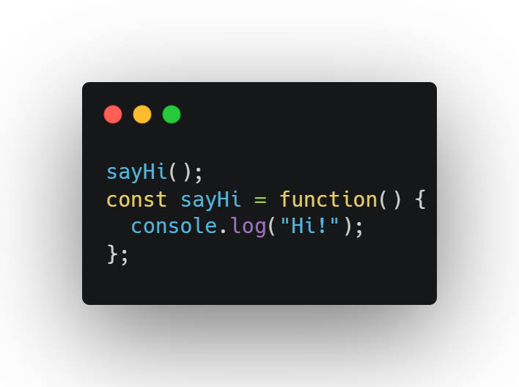
Hoisting:
Function expressions can’t be called before they're written.

Slide 15

Why This Matters?
Scope keeps variables safe from conflicts.
Defaults make functions flexible.
Hoisting explains why some code works or breaks.

Slide 16
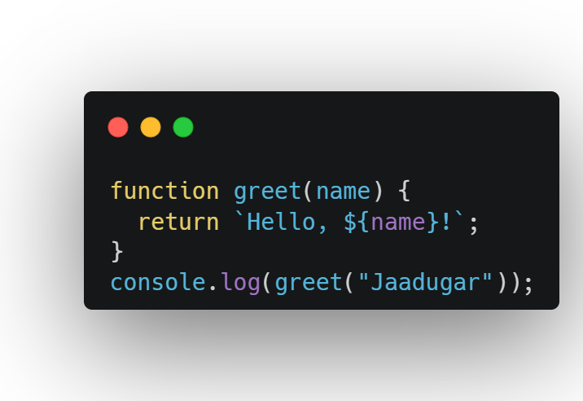
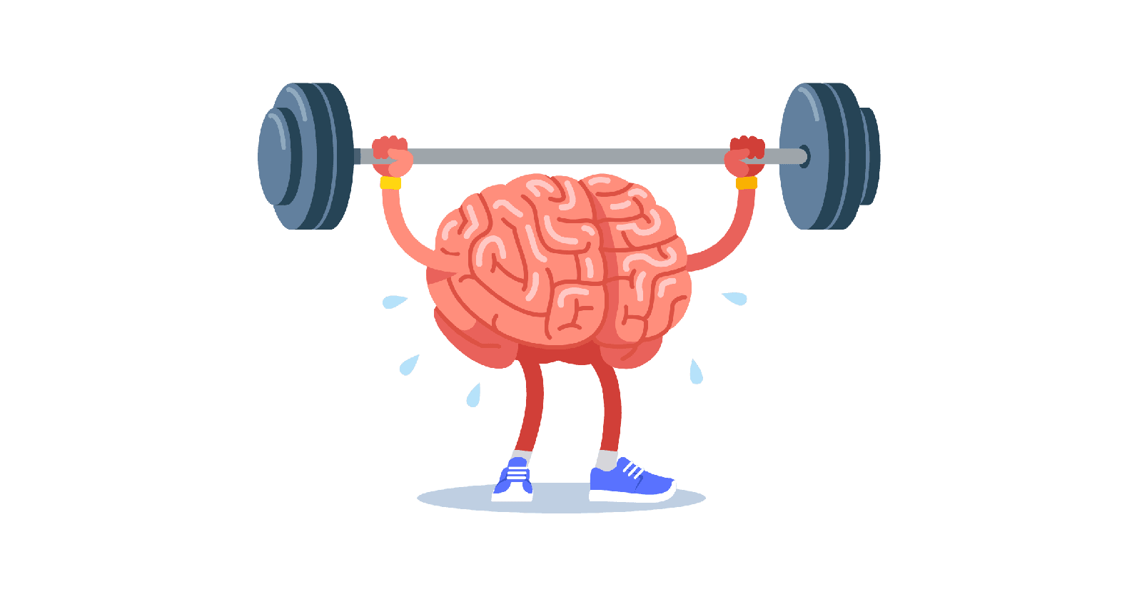
Question 1:

Slide 17
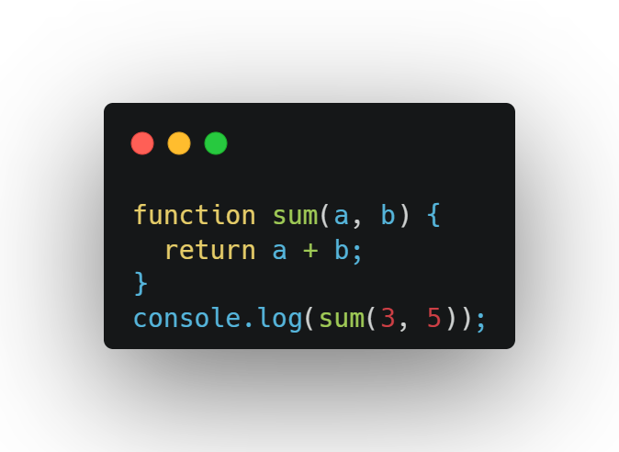
Question 2

Slide 18
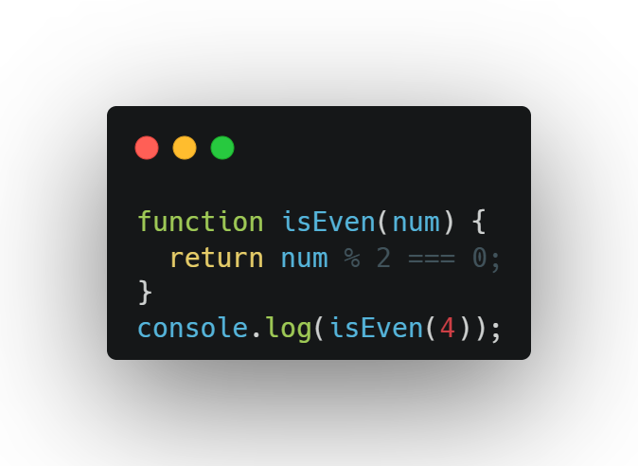
Question 3

Slide 19
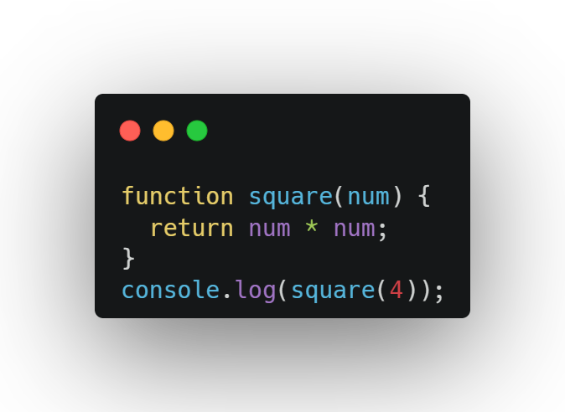
Question 4

Slide 20
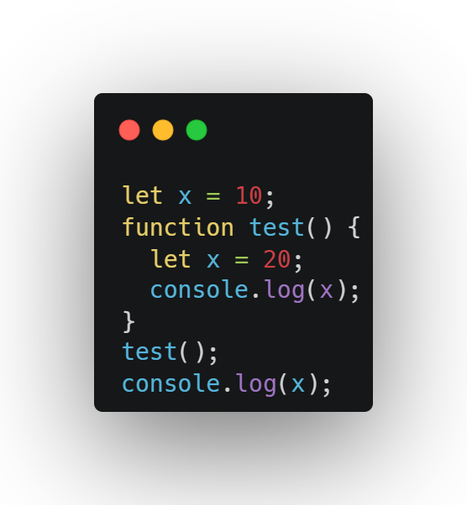
Question 5

Slide 21
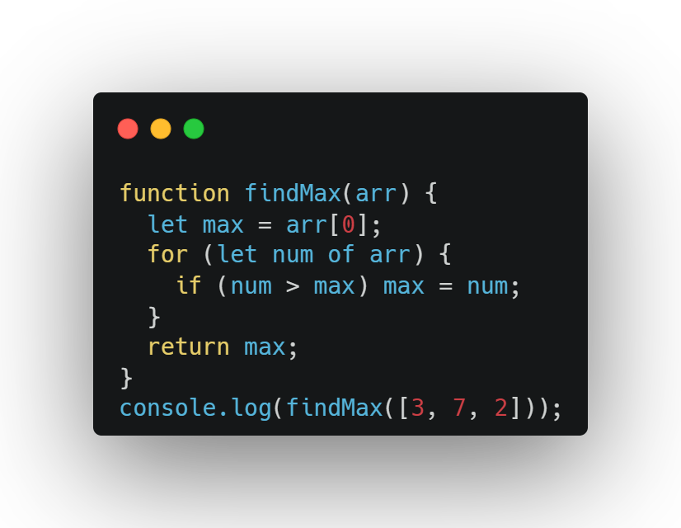
Question 6

Slide 22
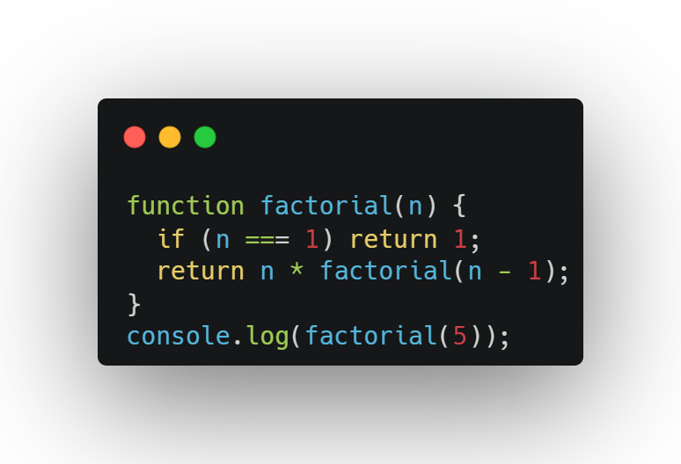
Question 7

Slide 23
Question 8

Slide 24
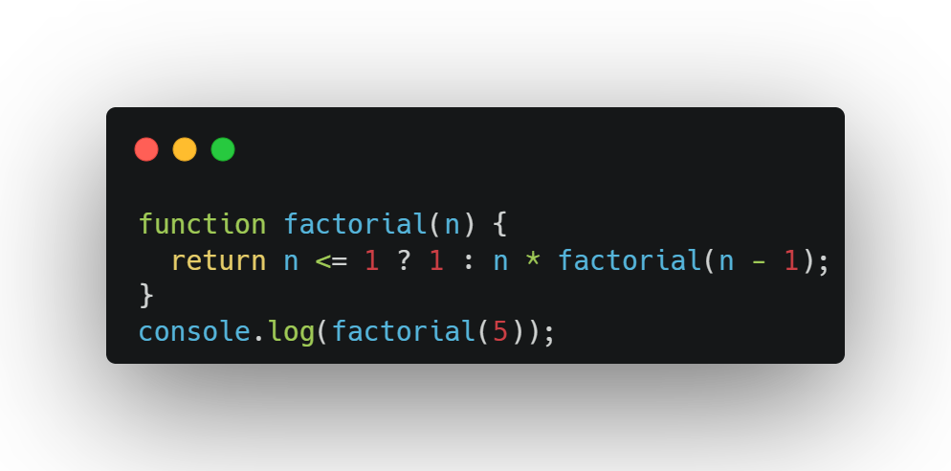
Question 9

Slide 25
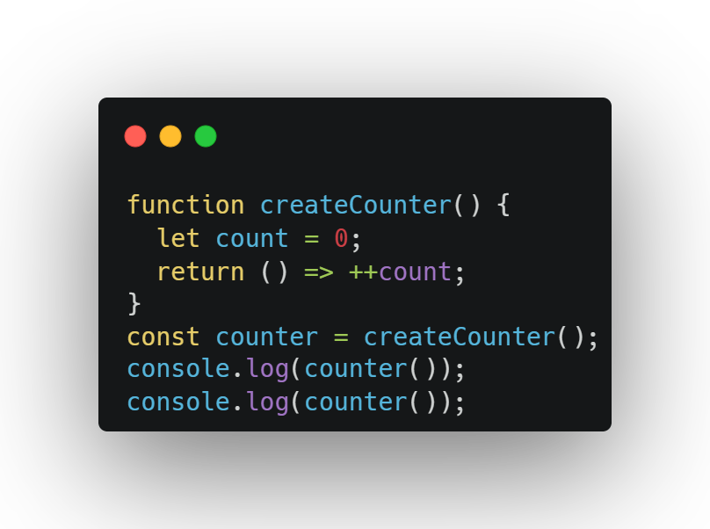
Question 10

Slide 26
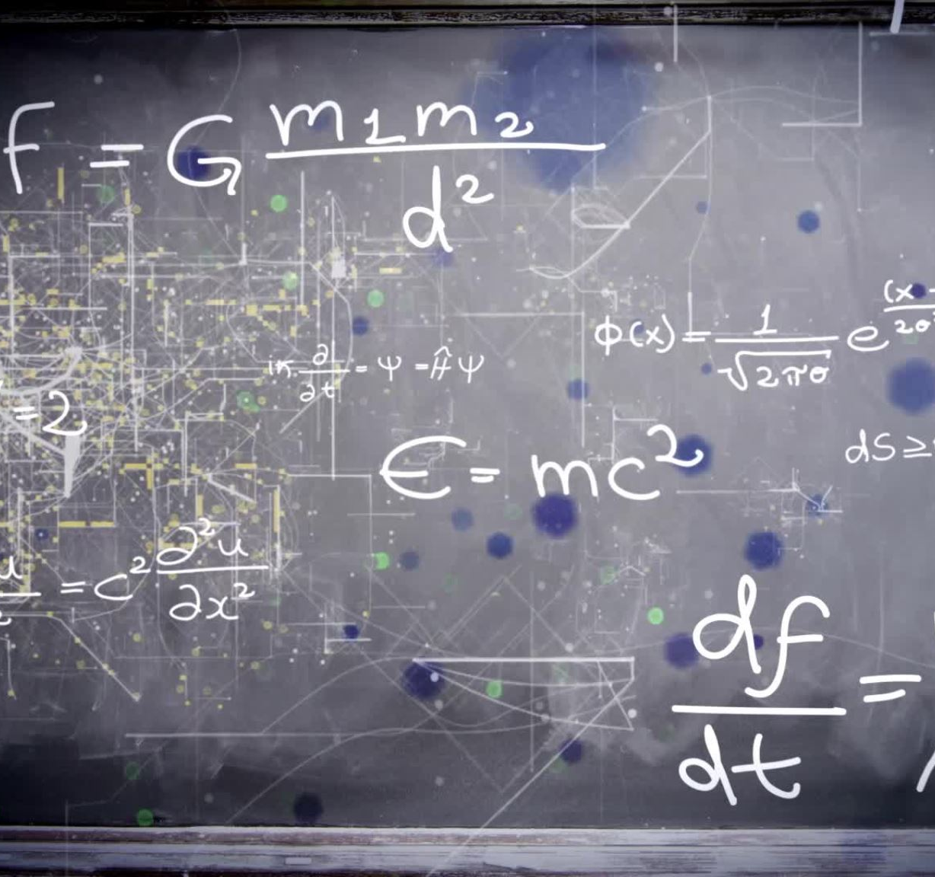
Functions with Conditionals

Slide 27
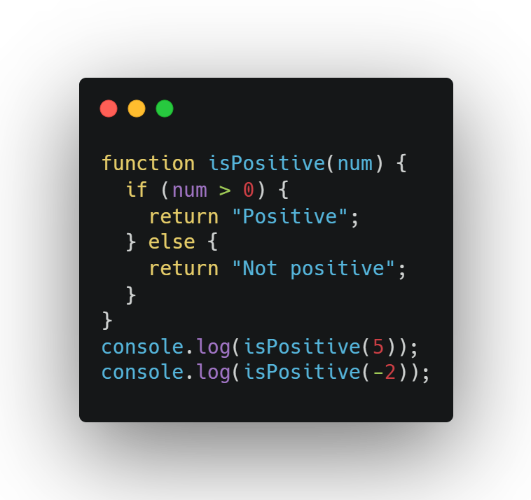
Why Use Conditionals in Functions?
Make decisions, like checking if a number is big or small.

Slide 28
Why Use It?
Check inputs (e.g., “Is this a valid number?”).
Return different results based on conditions.
Keep all logic in one place.

Slide 29
Tips:
Test with different inputs to see results.
Keep conditionals simple (use if, else if, else).
Use return to stop the function when done.

Slide 30

Arrow functions
An arrow function is a short way to write a function in JavaScript. It uses => instead of the word function.

Slide 31
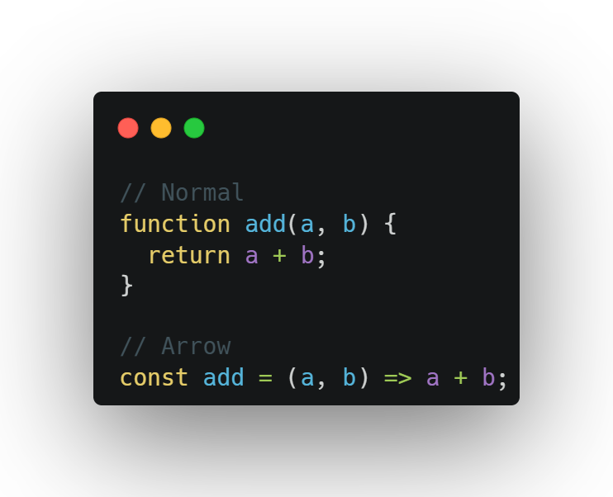
Arrow functions
An arrow function is a short way to write a function in JavaScript. It uses => instead of the word function.

Slide 32
Why Use Arrow Functions?
Shorter and cleaner code
No confusion with this
Perfect for .map(), .filter(), etc.
Easy to read and write

Slide 33
When not to Use Arrow Functions?
Inside object methods (because this won’t work)
When using new to create objects

Slide 34
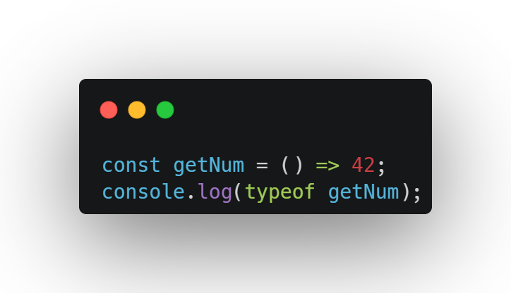
Question 1

Slide 35
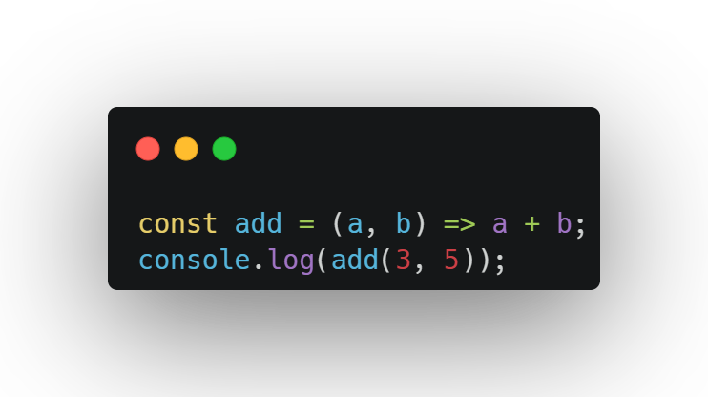
Question 2

Slide 36
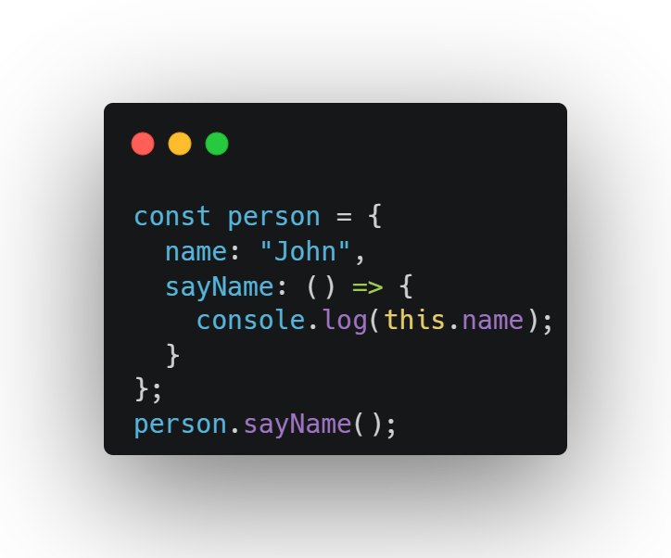
Question 3

Slide 37
Question 4

Slide 38
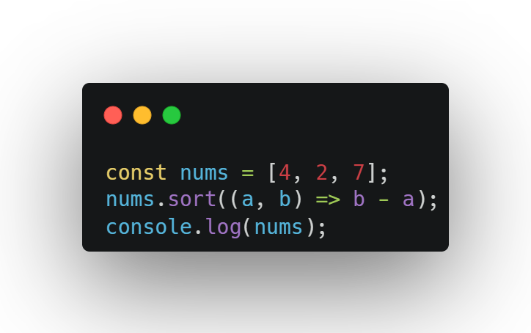
Question 5

Slide 39
Exercise

Slide 40
Exercise 1: Area Calculator
Goal: Calculate the area of a rectangle.
Steps:
Make a function calcArea with width and height parameters.
Return the area (width × height).
Print the area for width=4, height=5.
Output: 20.

Slide 41
Exercise 2: String Reversal
Goal: Reverse a string.
Steps:
Make a function reverseString that takes a string.
Reverse it using split, reverse, and join.
Print the result for "hello".
Output: olleh

Slide 42
Exercise 3: Greeting with Default
Goal: Greet with a default name.
Steps:
Make a function greet with a name parameter (default "Guest").
Return a greeting like "Hello, name!".
Print greetings for no input and "Jaadugar".
Output: Hello, Guest! and Hello, Jaadugar!

Slide 43
Exercise 4: Positive or Negative
Goal: Check if a number is positive, negative, or zero.
Steps:
Make a function checkNumber that takes a number.
Return "Positive", "Negative", or "Zero".
Print results for 5, 3, and 0.
Output: Positive, Negative, Zero

Slide 44
Exercise 5: Double Array
Goal: Double numbers in an array.
Steps:
Make a function doubleArray that takes an array.
Use a loop to double each number.
Return the new array.
Print the result for [1, 2, 3].
Output: [2, 4, 6]

Slide 45
Bonus question
Goal: Build a function to calculate a restaurant tip.
Steps:
Create a function calcTip that takes bill and tipPercent (default 15%).
Calculate the tip (bill * tipPercent / 100).
Calculate the total (bill + tip).
Log the tip and total with two decimal places (e.g., Tip: $3.00, Total: $23.00).
Test with bill=20 (use default tip) and bill=50, tipPercent=20.

Slide 46

“Why do we need return ?”

Slide 47

“Why do we need return ?”
Gives back a value from a function
Lets us use that value somewhere else (like in a variable or console)
Ends the function early—no code after it runs
"Function se kuch kaam kara lo, aur return se uska result wapas le lo!"

Slide 48
“What’s the difference between declarations and expressions?”

Slide 49
“What’s the difference between declarations and expressions?”
A declaration is when you define something like a variable or function.
Example: let name = "Mrigesh"; or function greet() {}
It doesn’t return a value—it just sets something up.
An expression is anything that produces a value.
Example: 3 + 2, "hello".toUpperCase(), or even (function() {})()
It can be stored, passed, or logged—because it gives you a result. "Declaration naam batata hai, Expression kaam karke result deta hai!"

Slide 50
“Why can’t I use a variable from inside a function?”

Slide 51
“What’s the difference between declarations and expressions?”
Variables created inside a function are in a local scope
That means they exist only while the function runs
Once the function ends, the variable is gone—you can't access it from outside "Jo cheez kitchen ke drawer mein hai, wo sirf wahi milti hai—poore ghar mein nahi!"

Slide 52


Slide 53

Recap...
Functions: Code blocks for tasks (e.g., greet(), calcTip()).
Declarations: function name() {} (hoisted).
Expressions: const name = function() {} (not hoisted).
Parameters: Inputs like bill or name.
Return: Gives back a result (e.g., return a + b).
Scope: Local variables stay inside functions.
Default Parameters: Fallback values (e.g., tipPercent=15).
Conditionals: Use if to make decisions in functions.

